Slide 1

KM Architecture
Foundation planning towards defining a ref. Model & blueprint

Slide 2

Overview
Needs Analysis
List of Deliverables
End State Vision for KM
A look into the future
Architecture Models & Decomposition
Functional Decomposition for KM
Functional Decomposition for Services
Metadata Deep Dive

Slide 3
Brief list of needs
Facilitate integration and repurposing of knowledge
  Provide broad search and retrieval capabilities
  Increase reuse and decrease redundancy across knowledge providers
Simplify and complete the knowledge life-cycle
  Reduce the number of user-facing knowledge entry points by using already existent business processes
  Manage knowledge end-to-end from initial inception to final disposition

Slide 4
Brief list of needs
Increase the value and quality of knowledge
  Build intelligent relationships among disparate sources of content using a federated metadata framework
  Define, enforce, monitor processes/procedures on knowledge collections to ensure quality
Consistent information security and disclosure enforcement
  HSP knowledge must be aligned via traceable and versioned metadata to ensure knowledge is consistent in order to facilitate disclosure policy compliance and information sharing for partners

Slide 5
Deliverables
High level reference model
High level architecture which drives abstraction and separation of disciplines
Design for a federated metadata solution which can be integrated with existing knowledge repositories and systems
Definition of networked taxonomy model that can be used to populate an initial footprint for an MDR.
List of tools and competencies we need to buy and/or develop to support the vision

Slide 6
Knowledge Management: End State Vision
The End State is achieved when:
  Any resource can capture and share knowledge
  Access to knowledge is transparent
  Capture of knowledge is seamless
  Knowledge achieves status as corporate asset (part of IP)
  The 5 rights for knowledge sharing have been achieved
    Right knowledge
    Right format
    Right amount
    Right timing
    Right resources

Slide 7
What’s the future state look like ?
Emails, documents, meetings and other work products that a knowledge worker touches in the context of a business topic are tightly related to each other and always available alongside any of the other
There is no need to figure out where to put a document, or an email, or a meeting note or even data – it will automatically be captured in relation to the context(s) in which they exist.
Records management, compliance, and security does not require additional effort
Business users may be associated with hundreds of contexts (or business topics and projects) but they will automatically have documents, emails and other content related to those contexts that are relevant to them at any time, when they are disconnected. Changes are synchronized and
All business information available on their laptop when off-line is encrypted and cannot be accessible to an unauthorized user.
Find people and content by looking up the context. Find people by the expertise needed for a context (or project). Find the content and their context using search – even emails written by others and documents that are work in process – if the user is authorized.

Slide 8
What’s the future state look like ?
People who share the context will share the information without having to email them around
Work products flow among contexts as people write emails – thereby reflecting the actual flow of knowledge
Business processes create standard structured contexts to represent the entities that are being processed
Rules for workflow automation can be applied at the context –
  To gather data, notify people, move content, restrict distribution or access
They focus on their business context – and everything they need for working on them is available
When they complete a document, or send an email – they are automatically captured in the business context.

Slide 9
Goals for a Reference Model
High level reference model enables:
  Open architectures – swapping in and swapping out components over time without loss of investment
  Appropriate functional growth at the component level
  Extensibility of content coverage
  Scalability of the architecture in terms of volume of content and level of use
  Emergence of an enterprise level thinking about how to manage content
  Enterprise level thinking about stewardship and governance of information

Slide 10
Basic Stuff: Architecture Layers
Agenda:
  The Presentation Layer responsible for all requests and replies to and from the enterprise;
  The Service Requestors (BP) Layer responsible for request/reply exchanges with ESB
  The Enterprise Service Bus Layer representing a common informational environment supporting uncoupled, guaranteed, standard-based information exchange between service requestors and producers;
  The Service Producers Layer – the former System Domain, comprised of business-related service clusters, exchanging messages with other ESOA participants through ESB.
  The Data Service Layer – the part of the Data Layer usually responsible for providing a Single View of Truth – the unified view of the Enterprise’s dispersed data;
  The Data Storage Layer represents the dispersed Enterprise Data Storages, including public and internal RDBMS, Data Warehouses, tapes, files, etc.
Presentation Layer
Service Consumer Layer
Enterprise Service Bus
Orchestration / Scheduling
Enterprise Asset Repository
Service Producers Layer
Data Layer
OS Layer
B-Wave Software ®. All Rights Reserved ©

Slide 11

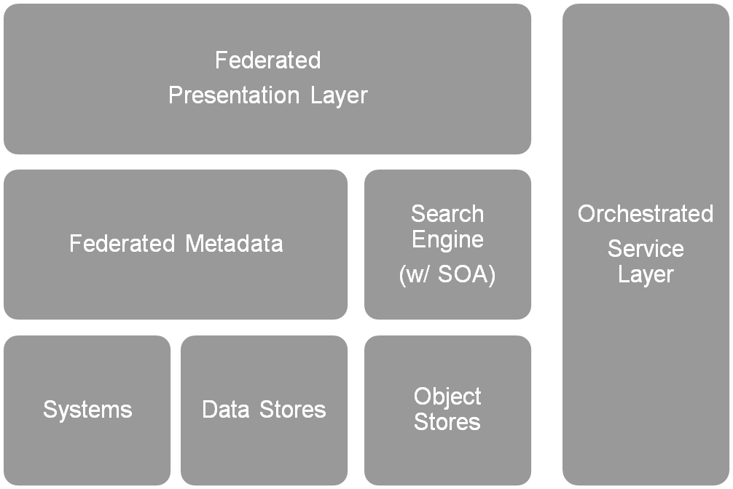
Conceptual Blueprint for KM

Slide 12

Metadata Governance Model
Site Specific
Searching
Publications
Catalog
HSP Catalog/
Enterprise Search
Recommender
Engines
Personal
Profiles
Portal Content
Syndication
Browse &
Navigation
Structures
Metadata Repository
Of HSP Standard Metadata
Reference Tables
Topics, Countries
Document Types
Transformation
Rules
Data
Governance
Bodies
Metadata
Extract
Metadata
Extract
Metadata
Extract
Metadata
Extract
Metadata
Extract
Metadata
Extract
Web
Content
Mgmt.
Metadata
Legacy
Systems
Industry
Standard
Models
ERP
System
External
Content
Internal
Content

Slide 13
Functional Decomposition for KM
Initial List of Functions
  Metadata
    Content Taxonomies
    People Taxonomies
    Functionality Taxonomies
  Asset Repositories
    Object Stores
    Production Data Stores
    Operational Data Stores
  Business Processes
    CRUD Processes
    Metadata ETL
    Content ETL (CMIS)
    Presentation Services
    Publish / Subscribe
Initial List of Functions
  Knowledge Capture
    Dynamic alignment of context with taxonomies
  Business Rules
  Presentation

Slide 14
Types of Knowledge
Explicit:
  Documents
  Data
  Publications
  Reports
  Collections
More factual in nature
Implicit:
  Collaboration
  Inferential content
  Reports
  Judgment
  Heuristics
More perceptual in nature

Slide 15
Decomposition of Services Layer
Content Integration Services
  Metadata harvest, rationalization and harmonization
  Access to metadata entries, content maps and content
Repository Services
  Defined storage strategy for content over time
  High performance, accessible and scalable metadata and content stores
Content Access Services
  Enterprise-wide search and retrieval
  Access control for all bank records
  Syndication of content to partners institutions – e.g. GDG

Slide 16
Basic Functional Components for Goals
Presentation Management Services
  Access to knowledge capture / sharing is integrated into existing applications via event-driven agents (triggered by buttons and/or actions w/in existing systems / interfaces)
Content Management Services
  Content management function oriented services – versioning, check-in/check-out, collaboration, work flow
Metadata Management and Security services
  Services managing reference data, data dictionaries, taxonomies, thesaurus, business rules (access, security, disposition) which cut across all services

Slide 17
Suggested Metadata Principles
Assume we will not change the current business systems
Challenge here is to manage complexity, maintain source systems, respect content security & still meet users expectations
Support integrated use by creating a warehouse of metadata pertinent to access, search, syndication, use management, knowledge mgmt compliance and learning
Define metadata attribute super classes to which existing business system metadata are mapped
Attributes may be rationalized, harmonized or value-controlled within super classes

Slide 18
Complexity suggests need for automation
Challenge to meet the scalability required using only human capture approach for tens & hundreds of thousands of content objects
Quality of metadata impacts quality of access – when we ask untrained catalogers to capture metadata quality suffers
Quantity of metadata needs to increase in order to support better access – three keywords not sufficient to support granular access, now we need to have 12 to 30 to describe an object
Consistency of metadata is better achieved programmatically with catalogers putting their expertise into high quality, full elaborated reference sources

Slide 19
Taxonomy Examples
Enterprise Topic Classification Scheme – hierarchical taxonomy
World Bank Thesaurus – English, French, Spanish – network taxonomy
Metadata Attribute Detailed Specifications – faceted taxonomy
Content Type Classification Scheme – hierarchical taxonomy
Transformation Rules – faceted taxonomy

Slide 20
Hierarchical Taxonomies
Hierarchical taxonomies structure content into at least two levels
Hierarchies are bi-directional
Each direction has meaning
Moving up the hierarchy means expanding the category or concept
Moving down the hierarchy means refining the category or the concept

Slide 21
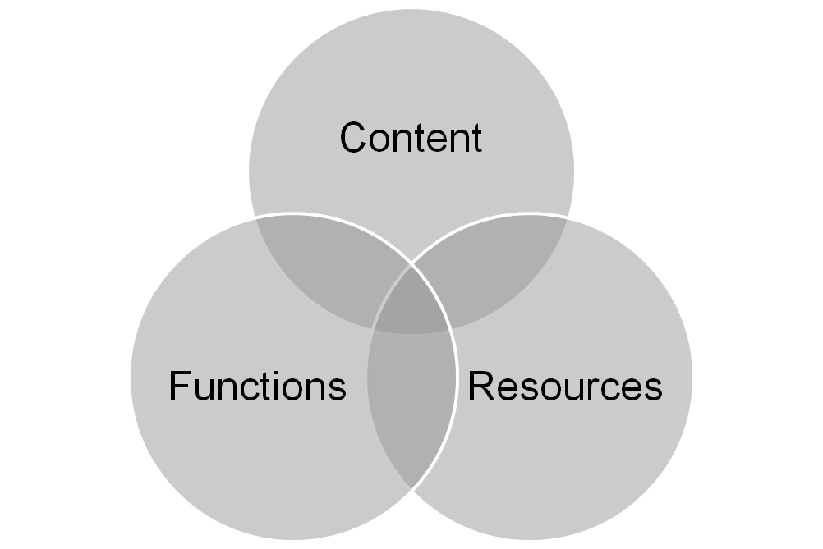
Core Taxonomy hierarchies for Metadata
Notes:
Review of Basic Concepts & Approaches
Essential concepts include:
content
metadata & metadata repositories
navigation architectures
search architectures
portal architectures
Information architectures in portals and web environments are increasingly complex, integrating technologies to deliver value to users. Seamless integration is the goal. Taxonomies are critical data structures that help us to build a sustainable foundation, to integrate efficiently and to manage the complexity. Whole information architecture is more adaptable and sustainable over time if it adheres to established standards and best practices. Whole Information Architecture is more cost effective if new technologies currently being researched or under development can be integrated without re-engineering the base. Like the content and processes they support, each component of a portal has a life cycle.

Slide 22
Networked Taxonomies
Taxonomy which organizes content into both hierarchical & associative categories
Combination of a hierarchy & star architectures
Any two nodes in a network taxonomy may be linked
Categories or concepts are linked to one another based on the nature of their associations
Links may have more complex meaningful than we find in hierarchical taxonomies

Slide 23
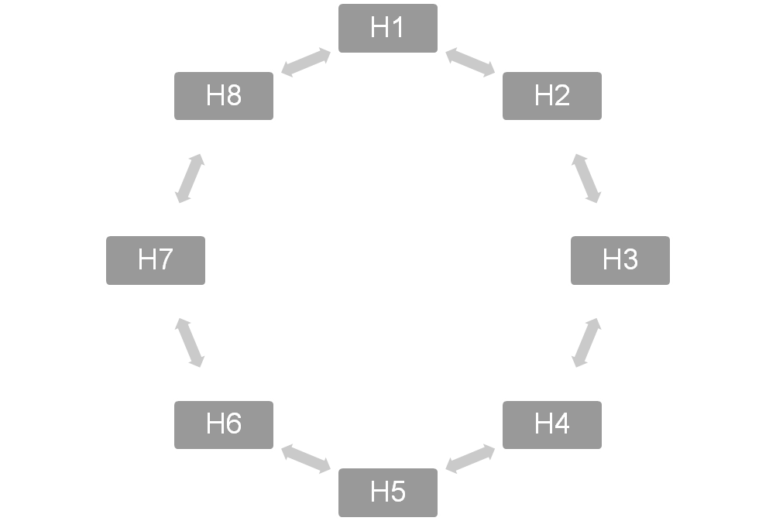
Network Model for Metadata

